Slide 1
Safetech Group Overview

Slide 2
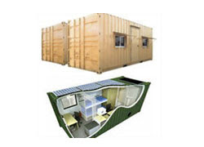
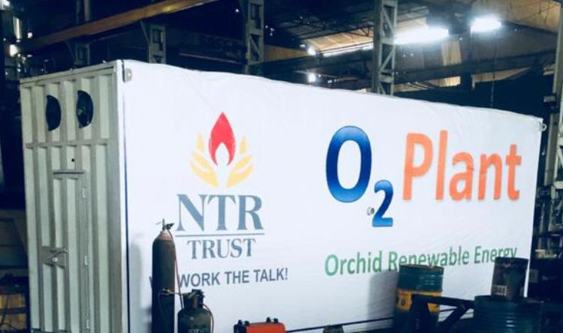
Prefabricated Hospitals
This department identifies and manufactures furniture and medical support systems that go into the making of a hospital, like hospital beds, tables chairs and various other support systems used in cabins, O.T or the stores. We can design, fabricate or modify medical aids like walkers, crutches or special trolleys which might be needed for specific needs of a trauma care unit, a burn unit or a female ward, like a specially designed toilet seat and support for the old or retarded. Our strength in this area comes from our industrial design department which has been involved in designing and developing various products ranging from high tech safety scalpel, to specialized tools, machines, and custom made electro mechanical equipments made from materials ranging from plastics to aluminum castings and sheet metals.

Slide 3
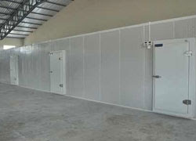
Cold Storage
A Cold Storage unit incorporates a refrigeration system to maintain the desired room environmental conditions for the ingredients to be kept. Backed by a team of skilful professionals, we are manufacturing, exporting, importing and supplying an ample arrangement of cold storage. The range is made with groove edges and are located together with cam lock fastener that can be unscrewed easily with the wrench. Designed with uttermost precision, this cold storage is manufactured from quality proven raw material that ensure its quality and performance. The storage capacity of the room depends on its construction and demand of the market. Attached with the updated locking facility, the provided room finds best application in distinct industries for storing various agro products with optimum safety and security. Moreover, the clients can avail this cold storage in several specification as per there convenience. Features: → Optimum Performance → Enhanced service life → Maintenance free → Humidity Control

Slide 4
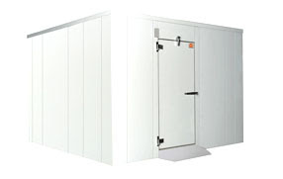
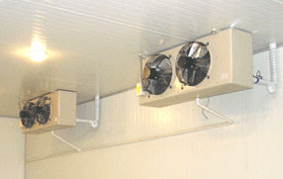
Cold Room
In today’s present scenario, the role of cold room has evolved a lot as to prevent wastage and to make maximum utilization of the food production. The need for conservation of resources becomes more relevant. At SAFETECH we offer cold room as per the specification of the client. Our Industrial refrigeration products, cooling equipment and services are innovatively designed to meet the challenge post by the changing world. We offer Modular cold room construction and large cold storage with PUF insulated panels and caters to food processing, Hospitality, Warehouses, Food Retail, Dairy, Ice cream industry, Meat chicken and Fish processing industry, Floriculture and others.

Slide 5
Cold Room
Features:
→ Walls of various heights and ceiling panels for longer spans with good thermal break suspender systems. → Doors with farmed hinge and handles along with release button from inside. → PVC/ Aluminum covering → International standard joining systems for wall to ceiling and wall to floor panels → Custom built & pre engineered construction with PVF insulated panels. Benefits:
→ Dry construction, quick and easy to erect → Ease of expansion and change in layout as the construction is pre engineered and modular in nature → High and consistent quality as the panels are factory made with Cam lock and non cam lock, both options Related product offering:
→ Cold Storage → Modular cold room → Pack houses → Dairy shed → Blast freezer room

Slide 6
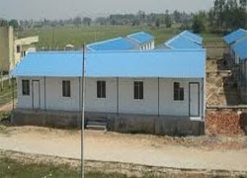
Labour Mess
The company is known for building clean room structures that is widely installed in several applications such as pharmaceuticals, medical devices, electronics, automobiles, food, nutraceutical & food ingredients, paint or coating booth and R&D. We provide clean room solutions beginning for enclosures and interface with the HVAC, electrical, and civil vendors at the design stage. These are compatible for the approval from regulatory bodies, which are USFDA, WHO and EUGMP.

Slide 7
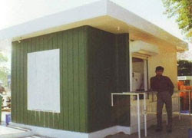
Prefabricated Kiosk
Our esteemed clients are provided with installation services for Prefabricated Kiosks, which is manufactured using optimum quality material. prefabricated Kiosks are the small cabins that are installed by us at the clients' end as per their specifications. Our professionals visit the site and do proper planning before executing the services. We make use of latest technologies and methodologies for providing the services as per high industry standards all India.

Slide 8
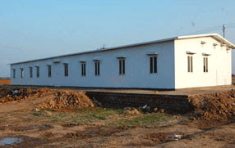
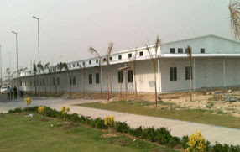
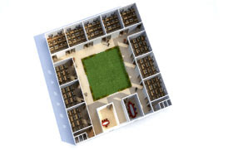
Prefabricated Health Centre
SAFETECH Prefabricated Porta Cabins are the most convenient solution for your onsite requirement. Porta Cabins are the optimal solution of frequent use of buildings in different locations. SAFETECH Prefab Porta-Cabins are designed by a panel of experts including architects, structural engineers, Interior designers, consultants and users. SAFETECH Porta Cabins are designed & developed based on standard ISO specification & conditions for end use, maintaining the highest structural stability, earthquake proof, weatherproof, leak-proof & faultless operation under extreme climatic conditions.
Prefab Health Centres
SAFETECH offers a wide range of modular Prefab Health Centre’s with PUF insulated panels/EPS insulated panels. Our prefab health centre’s can be designed to complement existing facilities or provide a modern appearance. We offer the solutions for modular prefab health centres with structure for hospitals and without structure for small prefab clinics.There is no compromise on specification either: the flexibility, the load bearing capacity of the prefab school building, quality of panels etc.we offers the complete turnkey solutions for prefab health centre’s under one roof starting from designing, fabrication, production and till installation. While designing the prefab health centre’s we consider factors like natural daylight, proper ventilation for fresh air for patients. Moreover these prefab health centres are constructed with insulated panels so these prefab schools are best suited to hot regions as well as cold regions too. At the time of natural disasters these prefab health centres are constructed in half of the time or less as compared to the permanent construction.

Slide 9
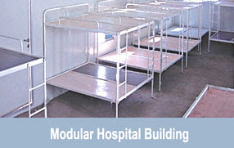
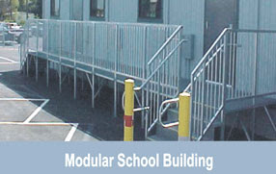
Prefabricated Health Centre
Features
SAFETECH BUNK HOUSES are available in various sizes,design and they have following features: → Aesthetic finish → No painting required – original baked paint on the surface of wall & roof → Adequate insulation 5-7 degree ‘C’ ambience temperature difference → All electrical facility – wiring, all socket, light fixtures as applicable. → No foundation required → Unit transportable by truck. → Great resistance to natural disasters → Weather proof Benefits
→ The Prefab schools/health centers are insulated resulting to higher energy savings and more comfort in adverse conditions due to insulation → Dry construction, Quick and easy to erect → Flexibility to choose various options on fascia of panels based upon the site conditions & requirements. → Flexibility of expansion and re-location → All weather proof construction

Slide 10
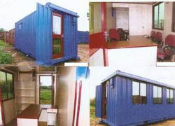
Modular Site Office
Our firm specializes in offering an impeccable Modular Site Office. In line with industry standards, the offered site office is designed using quality tested raw material and dexterous workmanship. Our offered site office is well-known amongst our clients for featuring variegated attributes like attractive look, perfect finish and optimum quality. Apart from this, it is made available at industry leading rates to our prestigious clients. Features:
→ Withstand adverse weather conditions → Elegant look → Excellent finish

Slide 11
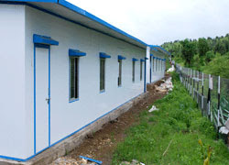
Workers Dormitory
We have seen in the recent times that the availability of workers is scare. Therefore it is very important for all organizations to retain them for long term. A major role for the same is played by the amenities provided by the employer. Majority of the organizations have started using insulated prefab worker accommodation / labour hutment for better and happier living of their staff and workers on the work site. Features:
→ Custom designed as per clients requirement and land availability. → Ready to move in structures. → Economical.

Slide 12
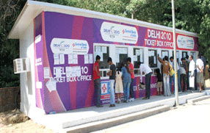
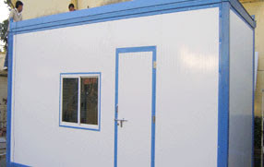
Porta Cabins
The main primacy of Porta cabins is that it is easy to transfer these cabins from one location to another. These cabins are widely recognized for their portability, weather resistance, proper electrical wiring and low maintenance. SAFETECH Porta cabins are the most convenient solution for client onsite requirement. Porta cabins are the optimum solution of frequent use of buildings in different locations. Our porta cabins are designed by the panel of experts including Architects, Structural Engineers, Interior Designers and consultants. This cabin is fabricated using high quality raw material and contemporary technology in compliance with set market quality standards. SAFETECH porta cabins are designed and developed based on standard ISO specification & condition for end use, maintaining the highest Structural stability, Earth quake proof, Weather proof, Leak proof and Faultless operation under extreme climatic condition. Portability:
→ These portable cabins can be used for several purposes such as → Accommodation → Site Offices → Stores → Toilet/Bath → Mess → Single Executive Accommodation → Fully equipped kitchen

Slide 13
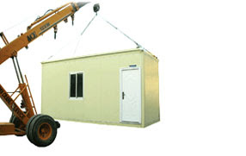
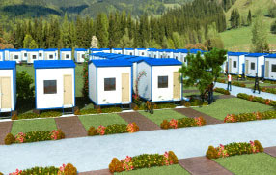
Porta Cabins
Features:
→ Weather Proof → Great resistance to natural disaster → No foundation required → Aesthetic finish → Adequate insulation 5-7 degree "C" ambience temperature difference → Unit transportable by truck Related product offering:
→ Modular Cabins → Flat pack Cabins → Bunk Houses → Container offices → Mobile Shelters

Slide 14
Workers Accommodation
SAFETECH HOUSING offers the most convenient & economical solution for insulated labour Hutment/workers accommodation. SAFETECH has carved a niche in the domain of manufacturing and supplying the finest quality of insulated labour hutment/workers accommodation. In the current scenario we have seen that the availability of labours is scarce, therefore it is very important for all organizations to retain them for long term. Understanding the problem of scarcity of labours, many of the organizations have started providing insulated prefab labour hutments/works accommodation for better & happier living of their worker on work site. SAFETECH designs a customized layout for all it clients as per their requirement & land availability. SAFETECH also provides G+1 or G+ 2 hutments in case of scarcity of land. There is no compromise on specification either: the flexibility, the load bearing capacity of the labour hutment, quality of panels etc. we offers the complete turnkey solution for labour hutment/workers accommodation under one roof starting from designing, fabrication, production till installation including electrical fittings, sanitary fittings, bunk beds etc which gives a client a ready to move in solution to all their construction needs. While designing the labour hutment we consider factors like natural daylight, proper ventilation for fresh air. Moreover these hutments /accommodation are constructed with insulated panels so these prefab labour hutments/worker accommodation are best suited to hot regions as well as cold regions too.

Slide 15
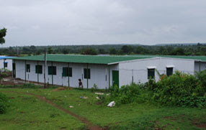
Workers Accommodation
Features
→ Custom Built & Pre-Engineered construction with insulated panels. → Customized design as per clients requirement & land availability. → Options available with various finishes like PPGI/PPGI, PPGI/PPGL, PPGI/GI with paint on one side, PPGI/Cement Bonded particle Board. → Walls of different height, yet sturdy & strong construction. → Light weight panels which is easy to lift & erect at any height on the roof too for extension purpose. → Fixing of smoke detectors, fire fighting equipments, AC's are easily possible for safety and better facilities. → These multi storey buildings are insulated resulting to higher energy savings and more comfort in adverse conditions due to insulation → Dry construction, Quick and easy to erect → Flexibility of expansion and re-location → All weather proof construction & maintenance free → Dismantle & Re-assemble easily without any cost loss. → Economical

Slide 16
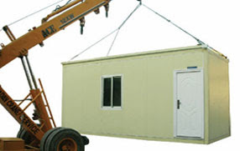
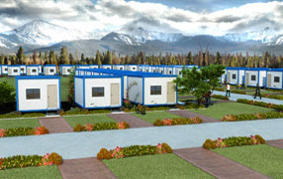
Portable Toilets
SAFETECH HOUSING Liftable cabins gives you a ready to move in solution to all your construction needs. With its unique design & technology, SAFETECH HOUSING turn out to be the largest manufacturer & supplier of insulated Liftable cabins which can be use for various applications like container offices, portable cabins, bunk houses, movable cabins, mobile shelters, portable toilets etc. These Liftable cabins can be designed to complement existing facilities or provide a modern appearance. These cabins are the most convenient & optimal solutions, where the use of such cabin is frequent because it can be easily lifted and shifted to another place. SAFETECH Liftable cabins are designed & developed on the basis of ISO specifications & user friendly conditions for end use keeping in mind the structural stability, earth quake resistant, weather resistant, leak resistant & faultless operation under extreme climatic condition. There is no compromise on specification either: the flexibility, the load bearing capacity of the cabin. The side walls & ceiling of the cabins are made up of insulated PUF/EPS panels which make them best suited to hot region as well as cold region too. SAFETECH Liftable cabins gives you a ready to move in solution to all your construction needs.

Slide 17
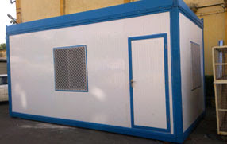
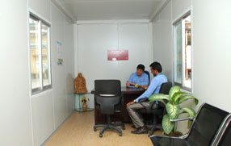
Portable Toilets
Features
→ No civil foundation is required; it can be easily placed on a plain surface. → Complete maintenance free, even though no paint is required, because the surface of the wall and roof is made up of Pre-Painted Galvanized iron sheet (PPGI). → Fixing of smoke detectors, fire fighting equipments, AC's are easily possible for safety and better facilities. → These Liftable cabins are insulated resulting to higher energy savings and more comfort in adverse conditions due to insulation → Complete earthquake resistant, weather resistant & leak resistant. → Very economical & durable. → It can also be dismantle & re-assemble. → It can easily transported in truck in dismantle form where distance is too long which also saves your transportation cost.

Slide 18
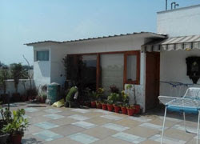
Prefab Cottage
Assisted by the vast industry understanding, we have been able to present Prefab Cottage. Our provided products are obtainable in several provisions so as to fulfill the necessity of patrons. These products are fabricated and developed at well-furnished production unit by making use of supreme-grade raw material and with the help of hi-tech machines. Also, offered products are tested on numerous quality restrictions to confirm its quality at patrons end. Features:
→ Perfect finish → Light in weight → Easy installation

Slide 19
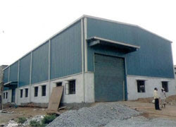
Prefabricated Warehouse
Owing to rich industrial experience, we are involved in presenting a huge array of Prefabricated Warehouse. This Prefabricated Warehouse is known for their optimum quality and durability. We provide these products to customers at market leading prices. Moreover, we provide these products to customers as per their requirements and needs. Features:
→ Top notch performance → Easy installation → Supreme strength

Slide 20
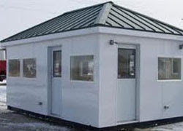
Guard Rooms
We are manufacturer and supplier of Guard Room for Security Guard that is precisely manufactured using utmost-grade raw material and the latest technology in tandem with set industrial norms. Owing to its durable finish and robust construction, our offered Guard Room is highly demanded among our precious clients. Features:
→ Long service life → Easy to clean → Corrosion resistant

Slide 21
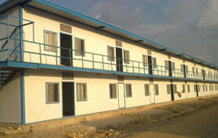
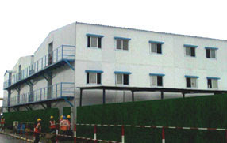
Prefabricated Double Storey Structure
SAFETECH HOUSING offers G+1, G+2, structures for labour accommodation in case of scarcity of land with PUF/EPS insulated panels. Safetech with its superlative quality, best designing & quick service, it turn out to be the leading manufacturer & supplier of quality G+1 building, G+2 building, multi storey building for various applications like, project offices, staff accommodation, workers accommodation, labour accommodation etc. Moreover these multi structure buildings are made up of PUF/EPS insulated panels, so it is best suited for the harsh environmental condition. SAFETECH designs & develops the structural framework for these multi storey buildings considering the wind load, live load, dead load & seismic zone etc. These double storey structures can be designed to complement existing facilities or provide a modern appearance. Safetech designs a customized layout for all it clients as per their requirement & land availability. While designing the labour hutment, we consider factors like natural daylight, proper ventilation for fresh air.

Slide 22
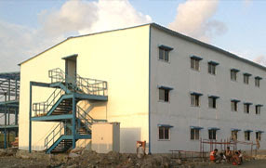
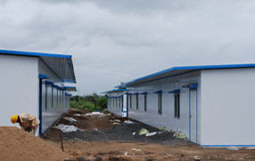
Prefabricated Double Storey Structure
We offer the complete turnkey solution for labour hutment and workers accommodation under one roof starting from designing, fabrication, production till installation including electrical fittings, sanitary fittings, bunk beds etc which gives a client a ready to move in solution to all their construction needs. A quick multi storey building with thermal & acoustic insulation, with the possibility to relocate & expansion is available at very economical rate. Features:
→ Custom Built & Pre-Engineered construction with insulated panels. → Customized design as per clients requirement & land availability. → Options available with various finishes like PPGI/PPGI, PPGI/PPGL, PPGI/GI with paint on one side, PPGI/Cement Bonded particle Board. → Walls of different height, yet sturdy & strong construction. → Light weight panels which is easy to lift & erect at any height on the roof too for extension purpose. → Fixing of smoke detectors, fire fighting equipments, AC's are easily possible for safety and better facilities. → These multi storey buildings are insulated resulting to higher energy savings and more comfort in adverse conditions due to insulation → Dry construction, Quick and easy to erect → Flexibility of expansion and re-location → All weather proof construction & maintenance free → Dismantle & Re-assemble easily without any cost loss. → Economical

Slide 23
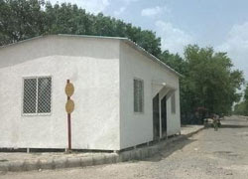
Prefabricated Labour Hutment
With the help of skillful professionals, we provide a wide range of Prefabricated Labour Hutment. These labour hutments are available in different shapes and designs. This labour hutment is extremely admired by our clients for their outstanding design and easy to fit. Our provided labour hutments are audited on well-defined industry parameters prior to its release. Features : → Easy to use → Long life service → Compact design

Slide 24
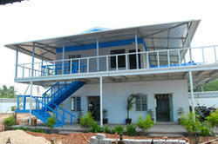
Low Cost Housing
SAFETECH HOUSING is possessing a huge production and project execution capability and experience, is looking forward to associate with major organization and government agencies to serve the rural areas by providing better living to people. We are the leading manufacturer and supplier of Low cost housing. We offer high quality range of prefabricated low cost housing. These are quite popular with our clients as they can be easily installed, assembled and dismantled. SAFETECH HOUSING has already served clients from all across the globe. We can make these houses as per the specification of the clients. This can be availed from us at market leading prices. Features:
→ Economical and Efficient → Quick and easy to install → Possibility of modification easily → Earth quake resistant and fire resistant → Easily Dismantle Specification: → WALL: PUF/EPS insulated sandwich panels of 50/60mm with PPGI sheet on both sides → ROOF: PUF/EPS insulated sandwich panels of 30/40mm or PPGI roofing sheet → DOORS: Insulated doors with all accessories will be provided → Windows: Aluminum anodized sliding windows will be provided → Electrical fitting, Sanitary fittings, Beds etc will be provided as per the need of the client

Slide 25
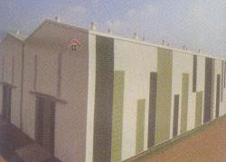
Labour Accommodation
Backed by the profound experience of the market, we have been able to manufacture and supply a range of Labour Accommodation. These products are constructed under the guidance of our experts, using modern machinery and superior quality material procured from the certified vendors of the market. Moreover, we also offer these products in varied specifications as per the requirements provided by the clients. We provide the offered products at market leading prices and within the stipulated time. Features:
→ Flawless finish → Withstand harsh weather conditions → Industrial approved design

Slide 26
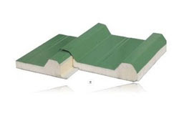
Insulated Sandwich Panel
With the support of our team, we have been able to bring forth the best-in-class range of Insulated Sandwich Panel. Manufactured by making use of high-grade basic material, these products are at par with the prevailing markets trends and industry laid parameters. Furthermore, to meet divergent demands of the clients, we offer these panels in variegated sizes and specifications at an economical price. Features:
→ Durability → Fine finish → UV protected → Water proof → Dimensional stability

Slide 27
Contact Us:
Plant :
Chhawchharia Engineering Pvt. Ltd.
C-19, 20&21, Adityapur Industrial Area Phase - 3,
Jamshedpur- 832109
Jharkhand, Ph. : +91 93346 15554
Corporate Office :
21, Ballygunge Circular Road,
Unit 20, CPC Complex, 3rd Floor,
Kolkata - 700 019 West Bengal
Mobile : +91 98307 82627
E-mail : info@safetechgroup.net / saurabh@safetechgroup.net
Website : www.safetechgroup.net

